Slide 1
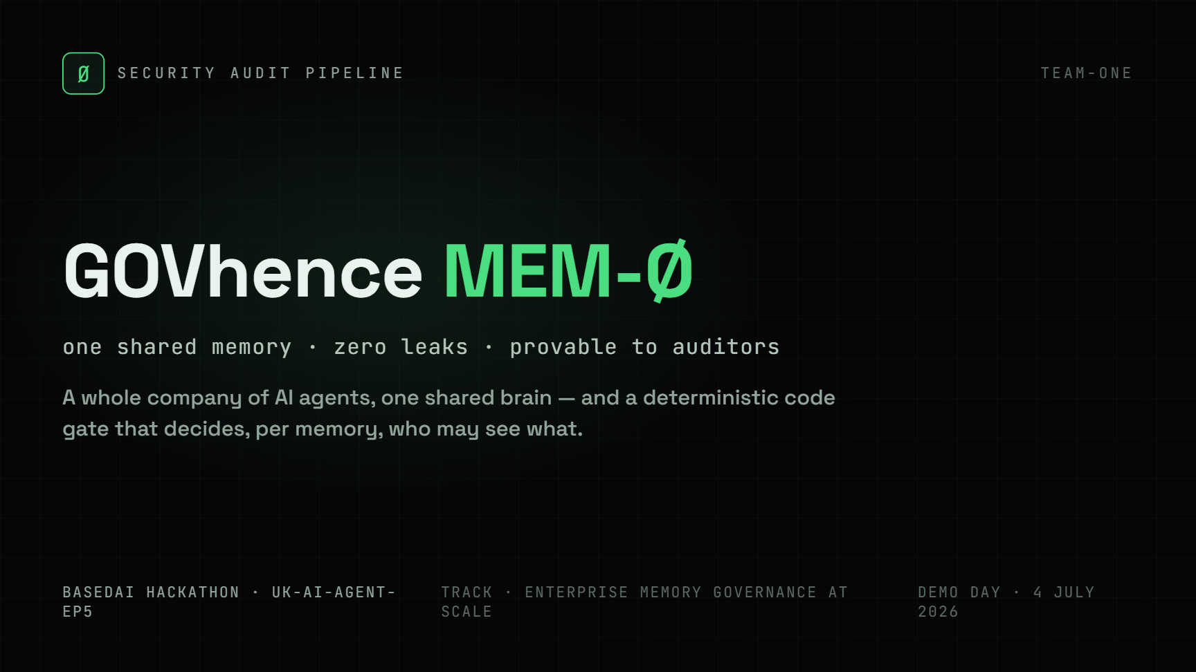
Benjamin Dacquay Alexis Dacquay

Slide 2
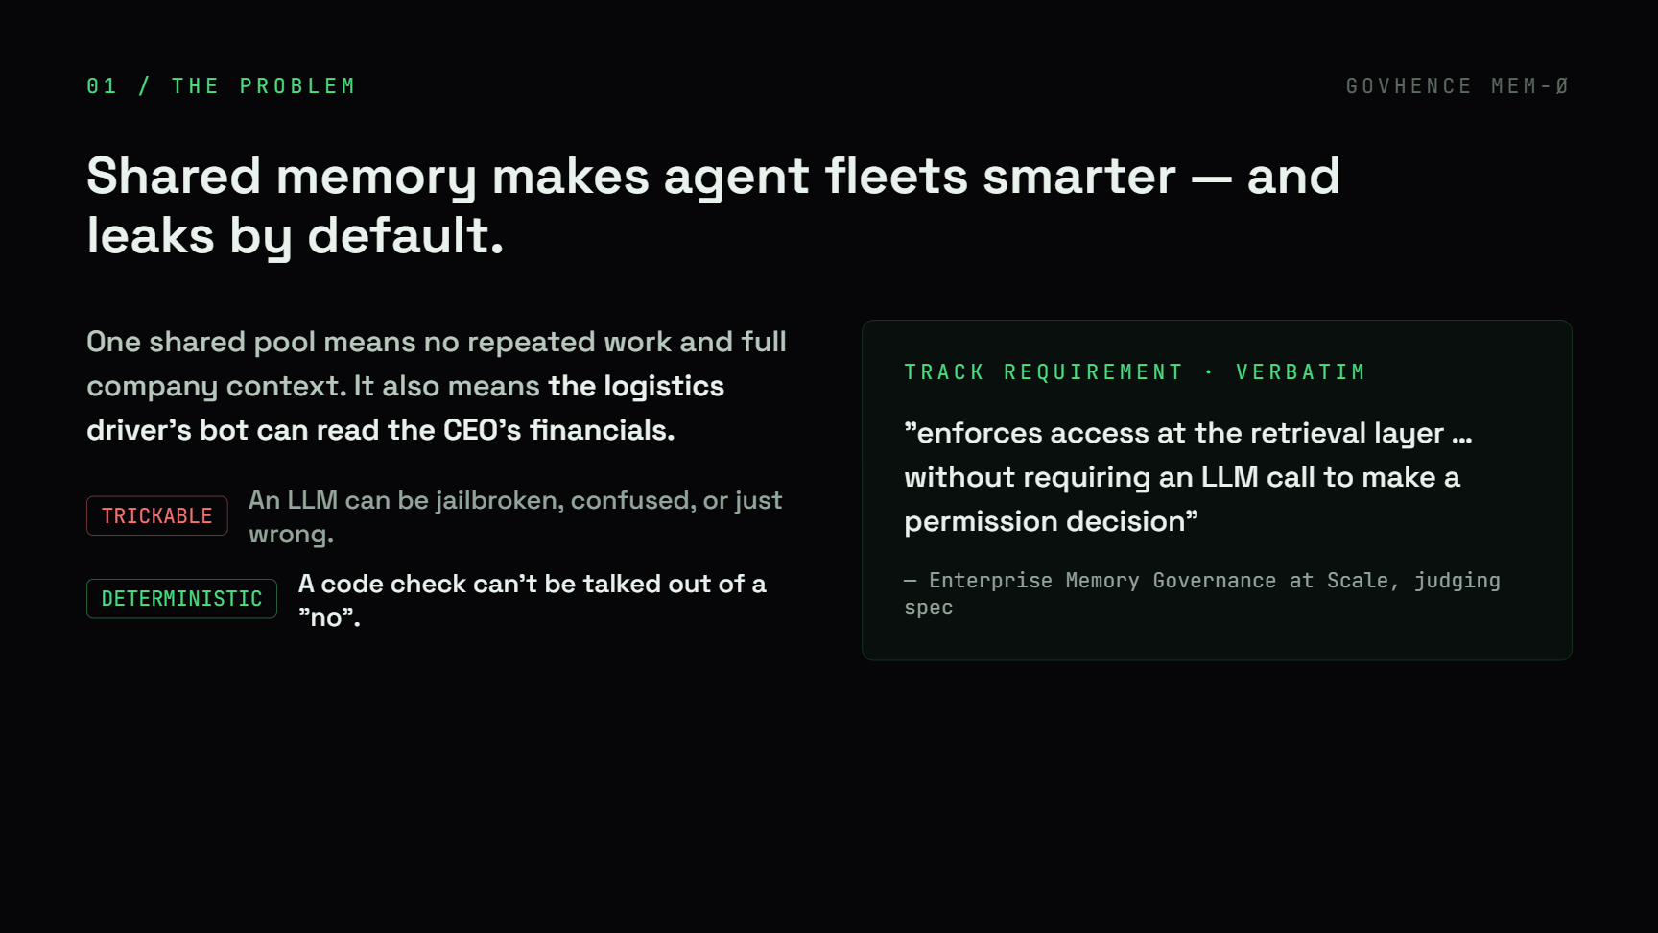

Slide 3
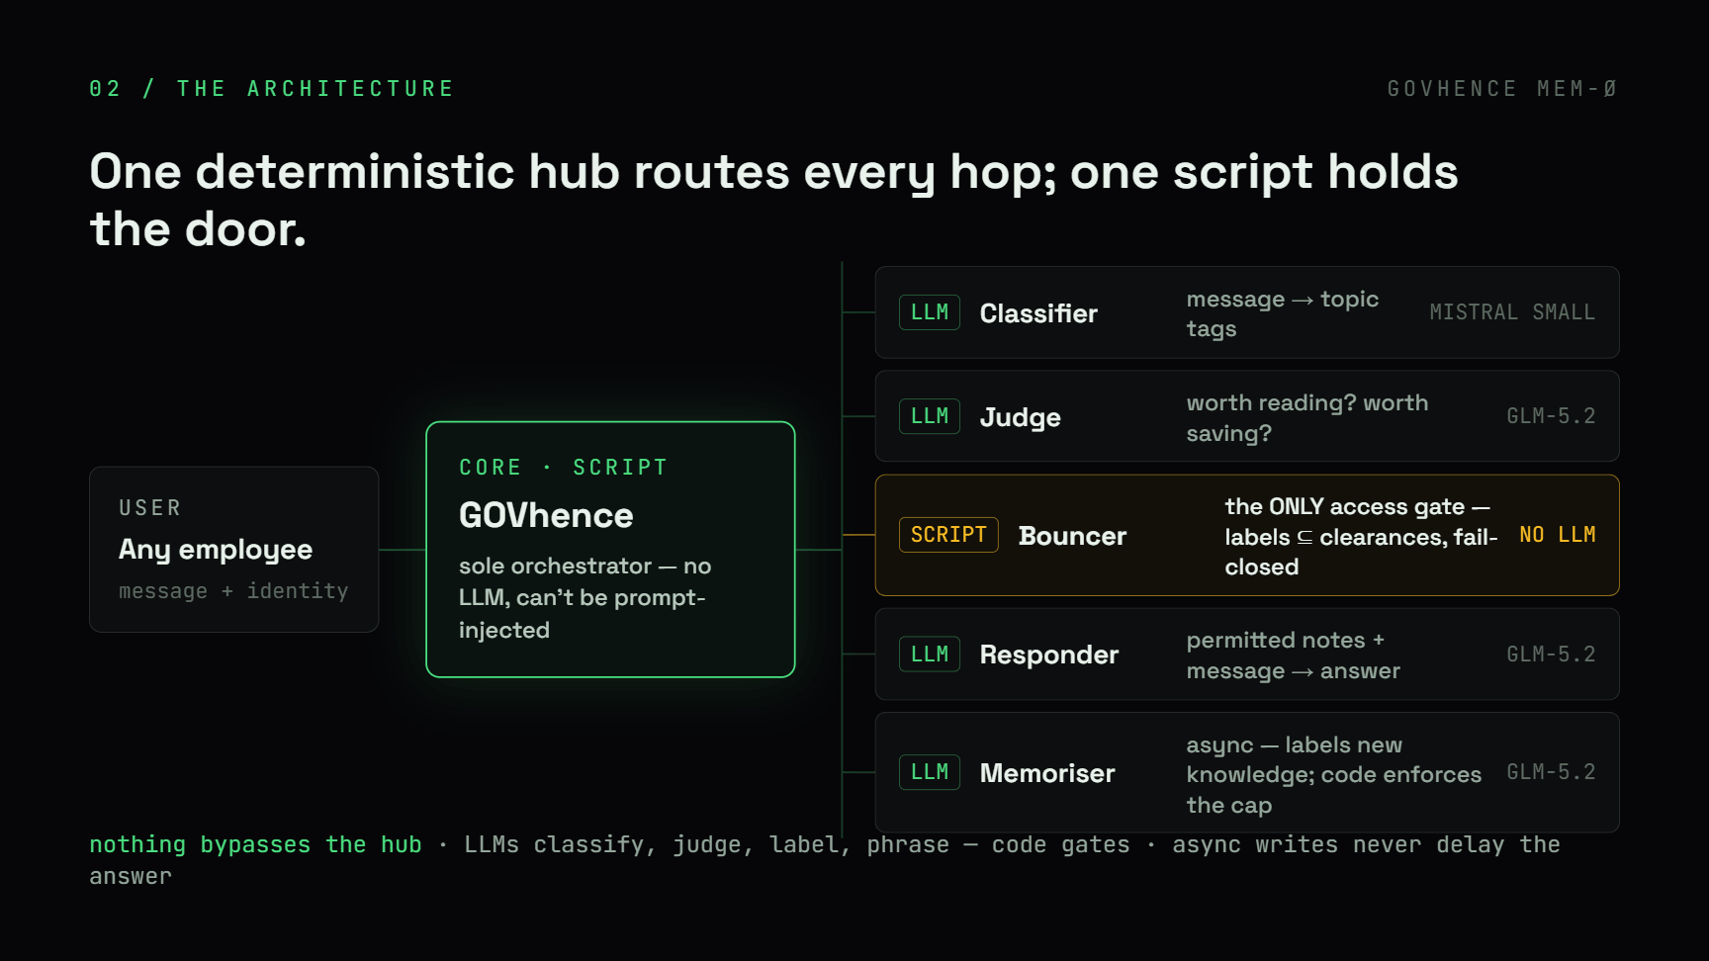

Slide 4
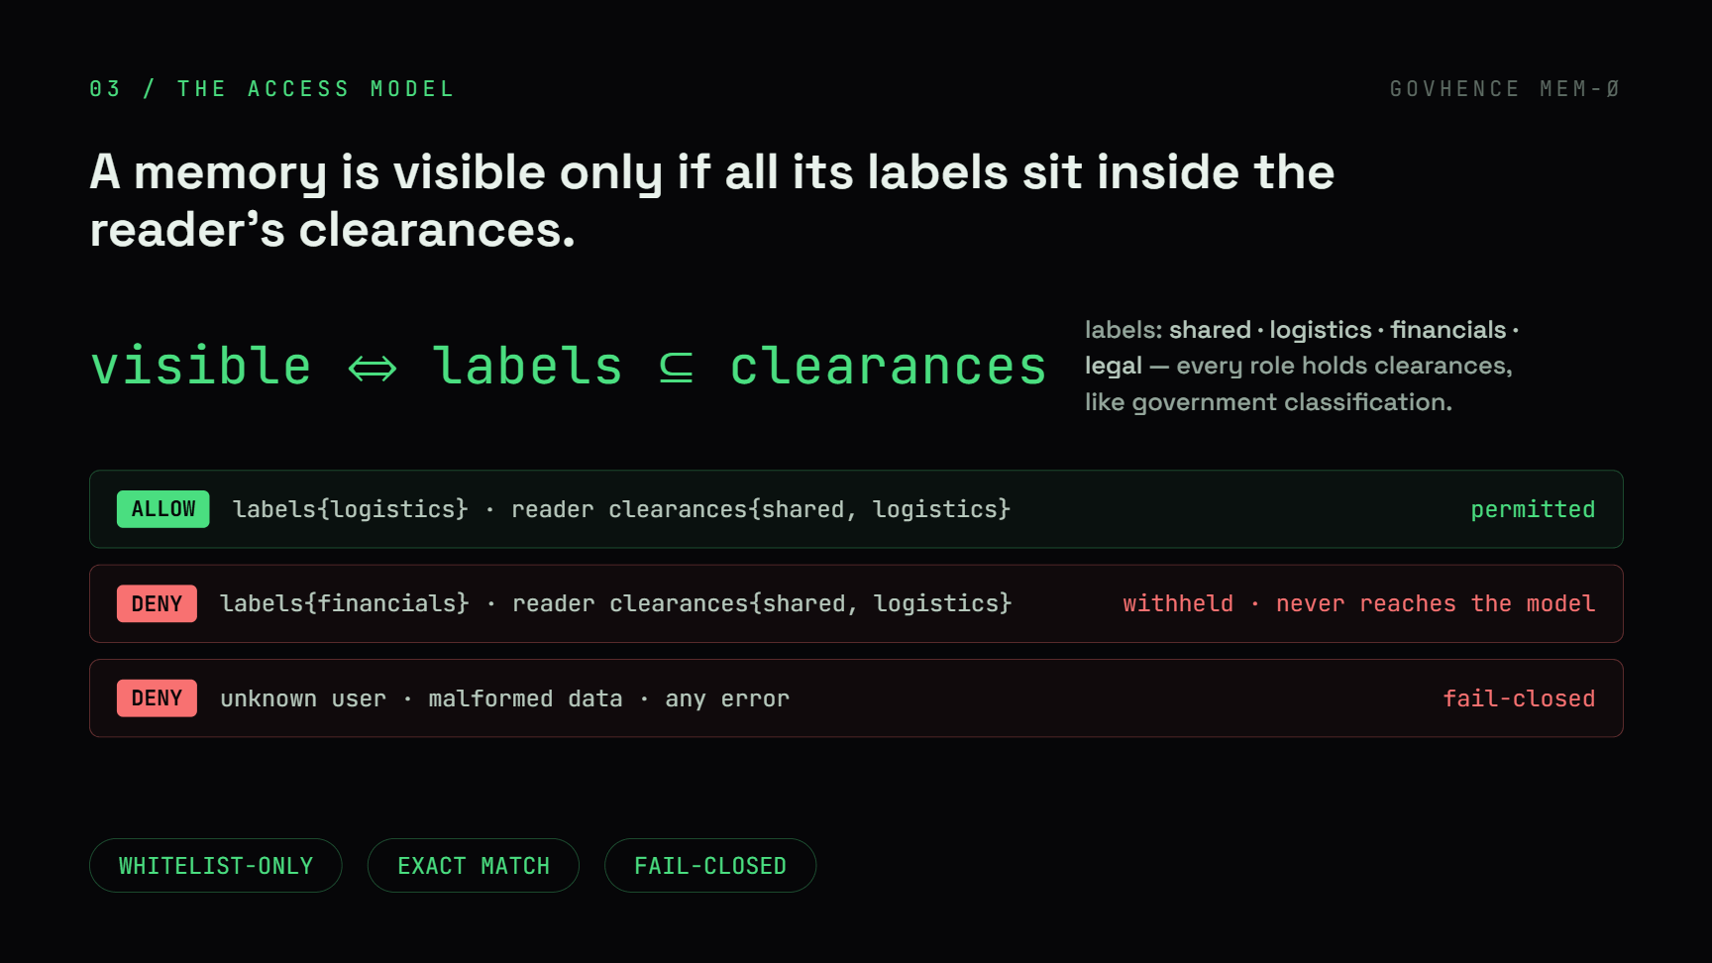

Slide 5
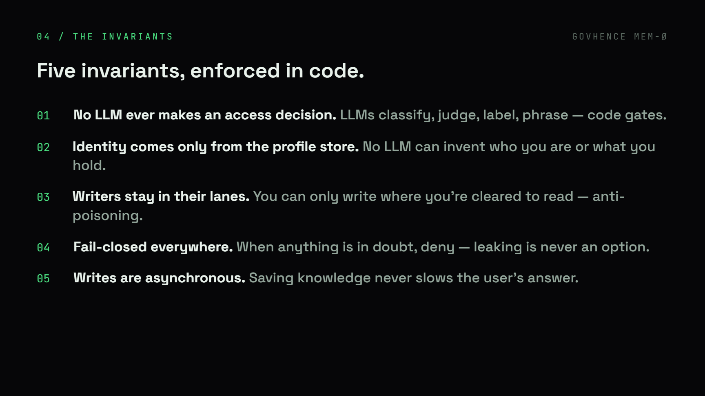

Slide 6
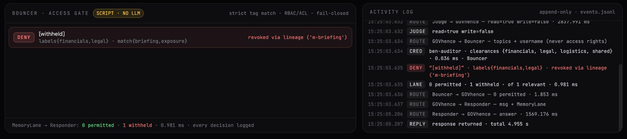
Revoke Lineage
Revoke a source → all derivatives revoked
Overrides clearance
Deterministic, fail-closed
Every decision logged

Slide 7
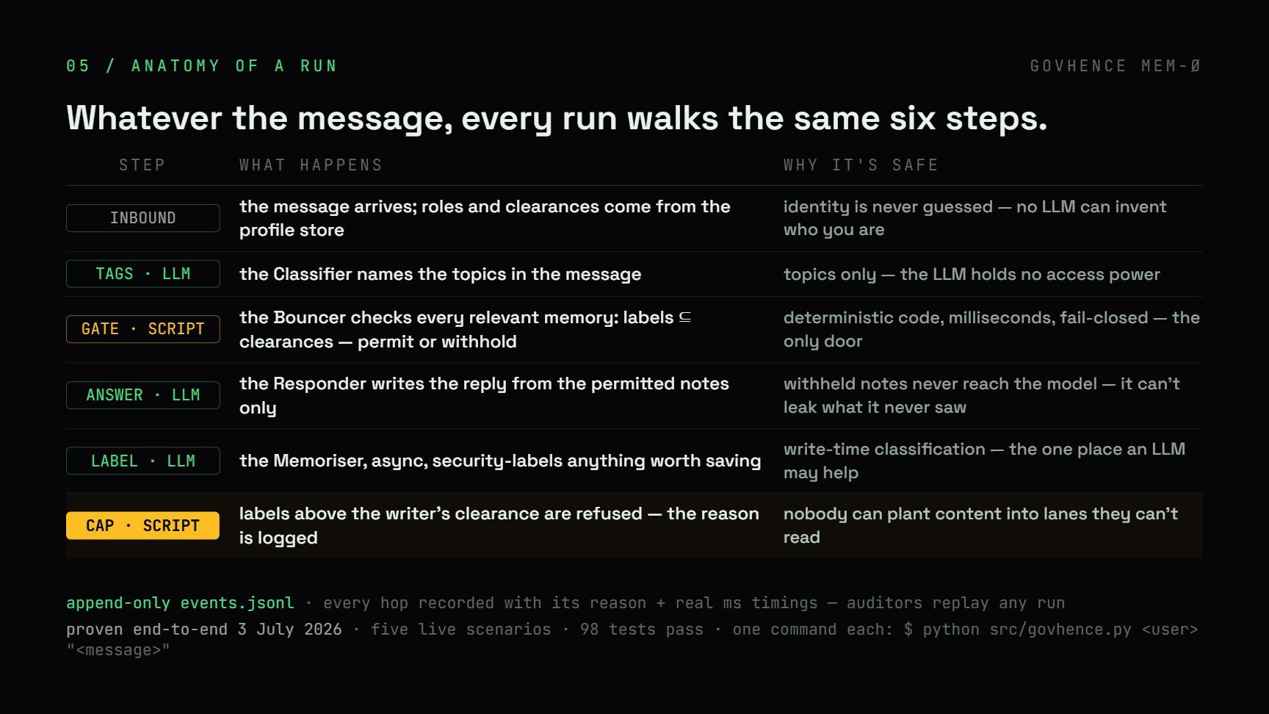

Slide 8
